Slide 1
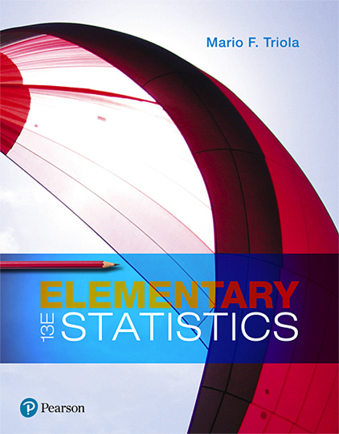
Elementary Statistics
Thirteenth Edition
Chapter 2
Exploring Data with Tables and Graphs
Copyright © 2018, 2014, 2012 Pearson Education, Inc. All Rights Reserved

Slide 2
Exploring Data with Tables and Graphs
2-1 Frequency Distributions for Organizing and Summarizing Data
2-2 Histograms
2-3 Graphs that Enlighten and Graphs that Deceive
2-4 Scatterplots, Correlation, and Regression

Slide 3
Key Concept
Introduce other common graphs that foster understanding of data.
Discuss some graphs that are deceptive because they create impressions about data that are somehow misleading or wrong.
Technology now provides us with powerful tools for generating a wide variety of graphs.

Slide 4
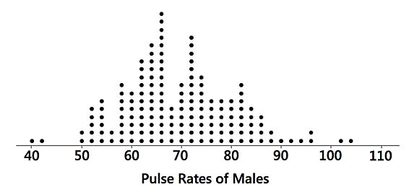
Graphs that Enlighten: Dotplots (1 of 2)
Dotplots
A graph of quantitative data in which each data value is plotted as a point (or dot) above a horizontal scale of values. Dots representing equal values are stacked.

Slide 5
Graphs that Enlighten: Dotplots (2 of 2)
Dotplots
Features of a Dotplot
Displays the shape of distribution of data.
It is usually possible to recreate the original list of data values.

Slide 6
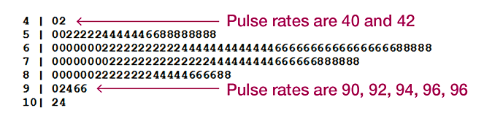
Stemplots (1 of 2)
Stemplots (or stem-and-leaf plot)
Represents quantitative data by separating each value into two parts: the stem (such as the leftmost digit) and the leaf (such as the rightmost digit).

Slide 7
Stemplots (2 of 2)
Stemplots (or stem-and-leaf plot)
Features of a Stemplot
Shows the shape of the distribution of the data.
Retains the original data values.
The sample data are sorted (arranged in order).

Slide 8
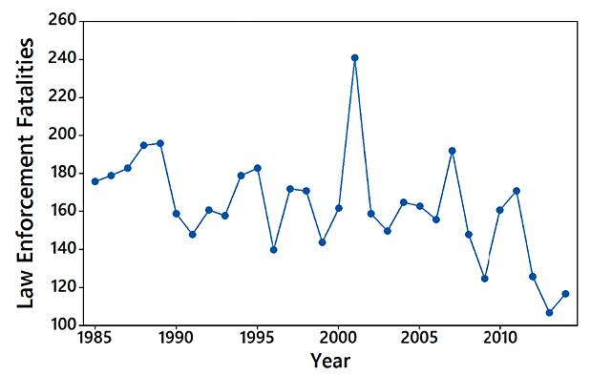
Time-Series Graph (1 of 2)
Time-Series Graph
A graph of time-series data, which are quantitative data that have been collected at different points in time, such as monthly or yearly

Slide 9
Time-Series Graph (2 of 2)
Time-Series Graph
Feature of a Time-Series Graph
Reveals information about trends over time.

Slide 10
Bar Graph (1 of 2)
Bar Graphs
A graph of bars of equal width to show frequencies of categories of categorical (or qualitative) data. The bars may or may not be separated by small gaps.

Slide 11
Bar Graph (2 of 2)
Bar Graphs
Feature of a Bar Graph
Shows the relative distribution of categorical data so that it is easier to compare the different categories.

Slide 12
Pareto Chart (1 of 3)
Pareto Charts
A Pareto chart is a bar graph for categorical data, with the added stipulation that the bars are arranged in descending order according to frequencies, so the bars decrease in height from left to right.

Slide 13
Pareto Chart (2 of 3)
Pareto Charts
Features of a Pareto Chart
Shows the relative distribution of categorical data so that it is easier to compare the different categories.
Draws attention to the more important categories.

Slide 14
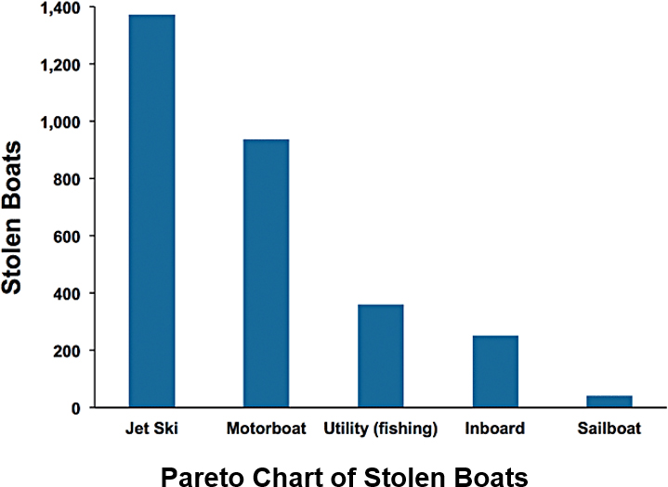
Pareto Chart (3 of 3)

Slide 15
Pie Chart (1 of 3)
Pie Charts
A very common graph that depicts categorical data as slices of a circle, in which the size of each slice is proportional to the frequency count for the category

Slide 16
Pie Chart (2 of 3)
Pie Charts
Feature of a Pie Chart
Shows the distribution of categorical data in a commonly used format.

Slide 17
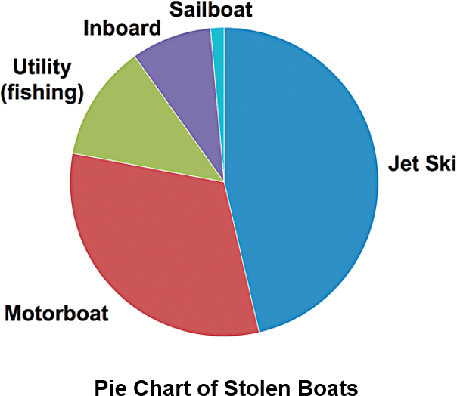
Pie Chart (3 of 3)

Slide 18
Frequency Polygon (1 of 3)
Frequency Polygon
A graph using line segments connected to points located directly above class midpoint values
A frequency polygon is very similar to a histogram, but a frequency polygon uses line segments instead of bars.

Slide 19
Frequency Polygon (2 of 3)
Frequency Polygon
A variation of the basic frequency polygon is the relative frequency polygon, which uses relative frequencies (proportions or percentages) for the vertical scale.

Slide 20
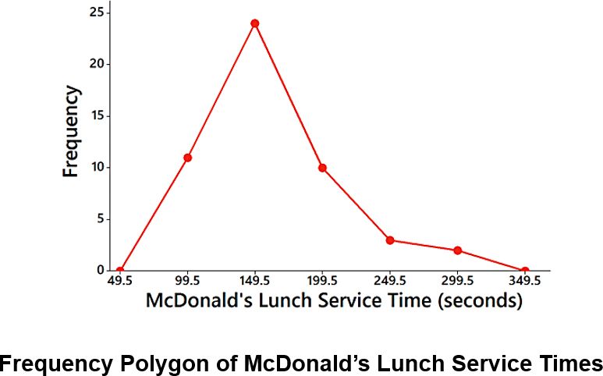
Frequency Polygon (3 of 3)

Slide 21
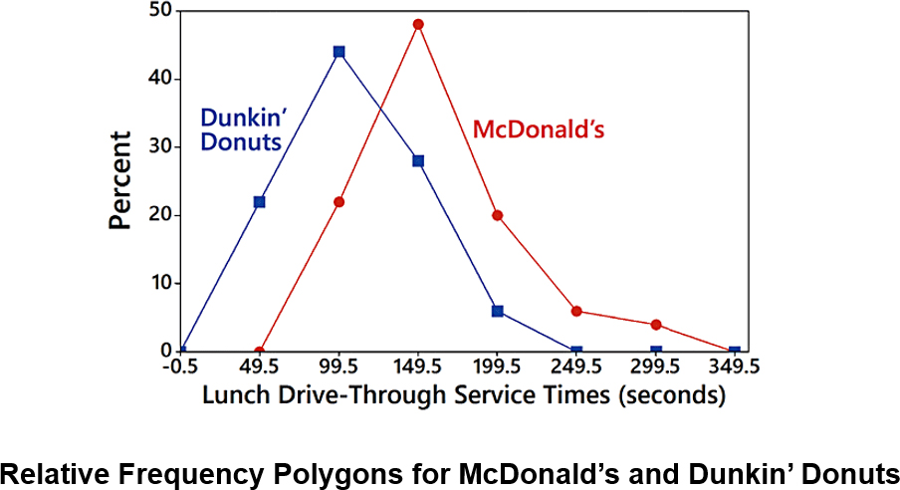
Relative Frequency Polygon

Slide 22
Graphs That Deceive (1 of 4)
Nonzero Vertical Axis
A common deceptive graph involves using a vertical scale that starts at some value greater than zero to exaggerate differences between groups.

Slide 23
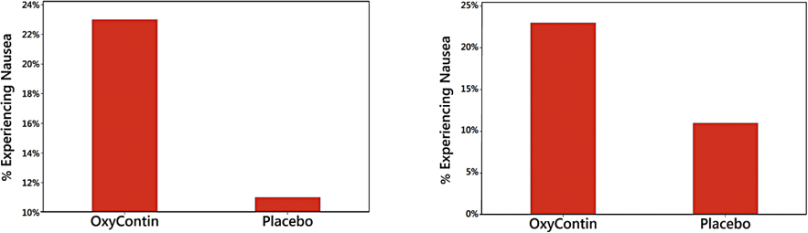
Graphs That Deceive (2 of 4)
Nonzero Vertical Axis
Always examine a graph carefully to see whether a vertical axis begins at some point other than zero so that differences are exaggerated.

Slide 24
Graphs That Deceive (3 of 4)
Pictographs
Drawings of objects, called pictographs, are often misleading. Data that are one-dimensional in nature (such as budget amounts) are often depicted with two-dimensional objects (such as dollar bills) or three-dimensional objects (such as stacks of coins, homes, or barrels).

Slide 25
Graphs That Deceive (4 of 4)
Pictographs
By using pictographs, artists can create false impressions that grossly distort differences by using these simple principles of basic geometry:
When you double each side of a square, its area doesn’t merely double; it increases by a factor of four.
When you double each side of a cube, its volume doesn’t merely double; it increases by a factor of eight.

Slide 26
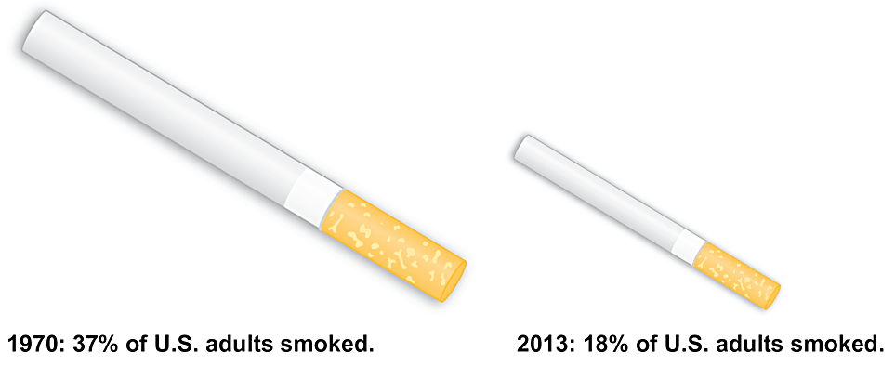
Pictographs

Slide 27
Concluding Thoughts (1 of 2)
In addition to the graphs we have discussed in this section, there are many other useful graphs - some of which have not yet been created. The world needs more people who can create original graphs that enlighten us about the nature of data.

Slide 28
Concluding Thoughts (2 of 2)
In The Visual Display of Quantitative Information, Edward Tufte offers these principles:
For small data sets of 20 values or fewer, use a table instead of a graph.
A graph of data should make us focus on the true nature of the data, not on other elements, such as eye-catching but distracting design features.
Do not distort data; construct a graph to reveal the true nature of the data.
Almost all of the ink in a graph should be used for the data, not for other design elements.

